Slide 1

HACKATHON 2022
IIT ROORKE
Project Report
Date : 27 & 28-Aug-22
Report By :
Deep Divers.

Slide 2
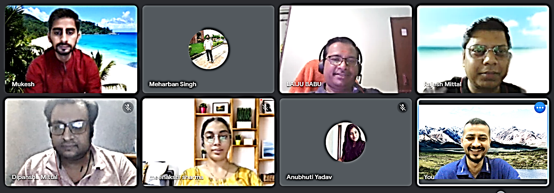
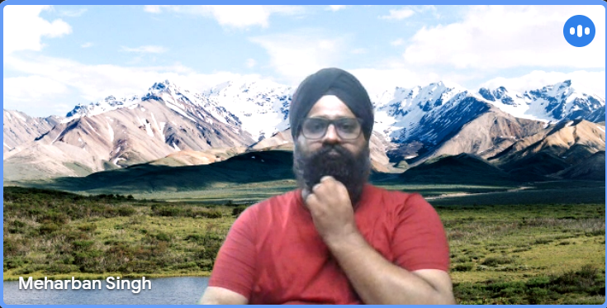
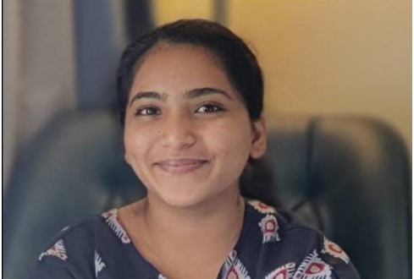
HACKATHON 2022
HACKATHON 2022
Deep Divers
Team Members :

Slide 3
Deep Divers
HACKATHON 2022
【Team Structure】
Coordinator AB/DM/TR
Team 01 RM
Team 01 MS
Team 01 LB
Team 02 MS
Team 02 MG
Team 02 AY

Slide 4
Deep Divers
HACKATHON 2022
【Approach】
Section 01 : Problem Statement.
Historical Data.
Type of Data & missing data
Planning – Milestone set-up.
Section 02 : Data cleaning & EDA.
Data cleaning & EDA.
Univariate/ Bivariate/Multivariate analysis.
Descriptive analysis.
Section 03 : Machine Learning & Model building.
ML Modeling – Logistic/Random forest/ Decision Tree.
Hyper tuning .
Record Various – Model performance.
Section 04 : Conclusion.
Comparison, GD & Selection – best ML Model .
Test result with Test Data set.

Slide 5
Deep Divers
HACKATHON 2022
【Approach】
Section 01 : Problem Statement.
Historical Data.
Type of Data & missing data
Planning – Milestone set-up.
Section 02 : Data cleaning & EDA.
Data cleaning & EDA.
Univariate/ Bivariate/Multivariate analysis.
Descriptive analysis.
Section 03 : Machine Learning & Model building.
ML Modeling – Logistic/Random forest/ Decision Tree.
Hyper tuning .
Record Various – Model performance.
Section 04 : Conclusion.
Comparison, GD & Selection – best ML Model .
Test result with Test Data set.

Slide 6
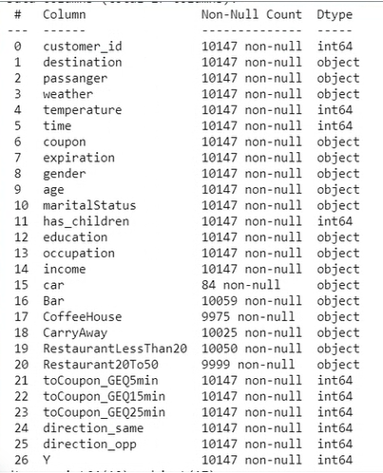
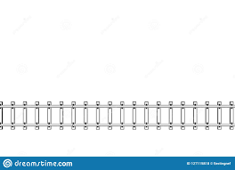
Section 01 : Problem Statement.
Objective :
In Order to increase Customer footfall, improve current Model to determine weather customer will accept recommended coupon or not to improve user rate.
1. Historical Data : Train Data – 10, 147/- records with 25 Features.
2. Type of Data & missing data: Identification of Colum with Null values .
OBJECTS WITH NULL : CAR,BAR, COFFEHOUSE, CARRYAWAY, RESTAURANTLESSTHAN20 & RESTAURANT20TO50
Data cleaning & EDA
Machine Learning & Model building
Conclusion
3. Planning : Milestone set-up.
Start
Major MS -01
27-08-22
10:30 AM
Major MS -01
27-08-22
10:00 PM
28-08-22
10:00 AM
28-08-22
12:00 Noon
28-08-22
10:00 PM
28-08-22
11:55 PM
Time Line

Slide 7
Deep Divers
HACKATHON 2022
【Approach】
Section 01 : Problem Statement.
Historical Data.
Type of Data & missing data
Planning – Milestone set-up.
Section 02 : Data cleaning & EDA.
Data cleaning & EDA.
Univariate/ Bivariate/Multivariate analysis.
Descriptive analysis.
Section 03 : Machine Learning & Model building.
ML Modeling – Logistic/Random forest/ Decision Tree.
Hyper tuning .
Record Various – Model performance.
Section 04 : Conclusion.
Comparison, GD & Selection – best ML Model .
Test result with Test Data set.

Slide 8
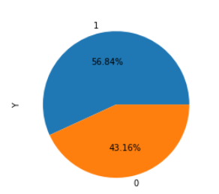
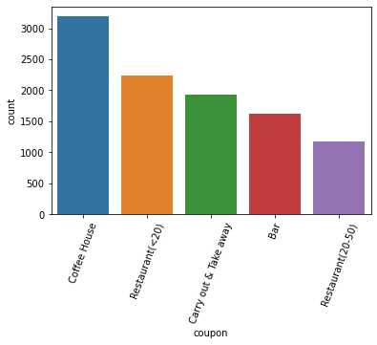
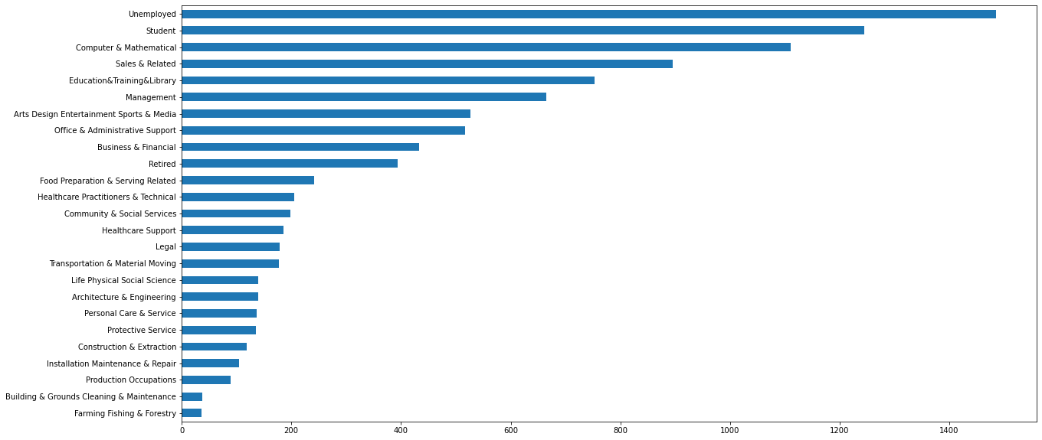
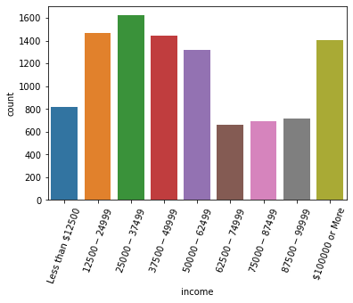
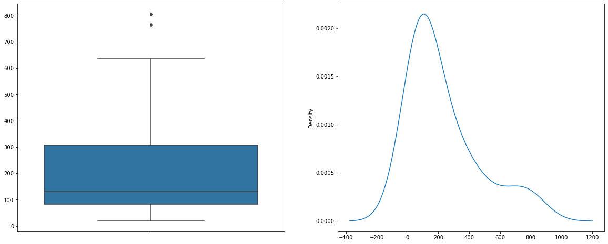
Section 02 : Data cleaning & EDA.
.
1. Data cleaning & EDA:.
Missing Value Treatment: As Categorical missing value replaced with – Mode.
Change Data Type : Column –Time & Age change from Object to int64.
2. Univariate/ Bivariate/Multivariate analysis:
Univariate analysis : Studied all variable
“Y” :: Normality ok.
“coupon” :: Bar plot
“occupation” :: 25 Unique values
“Income” :: Bar plot
Outlier

Slide 9
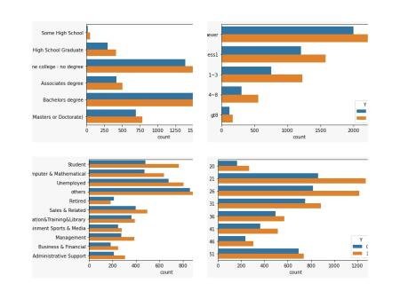
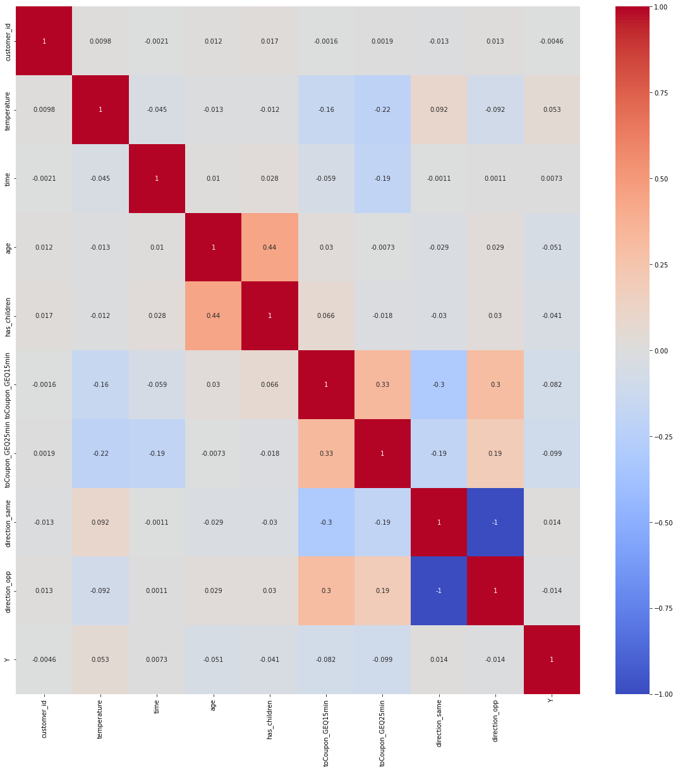
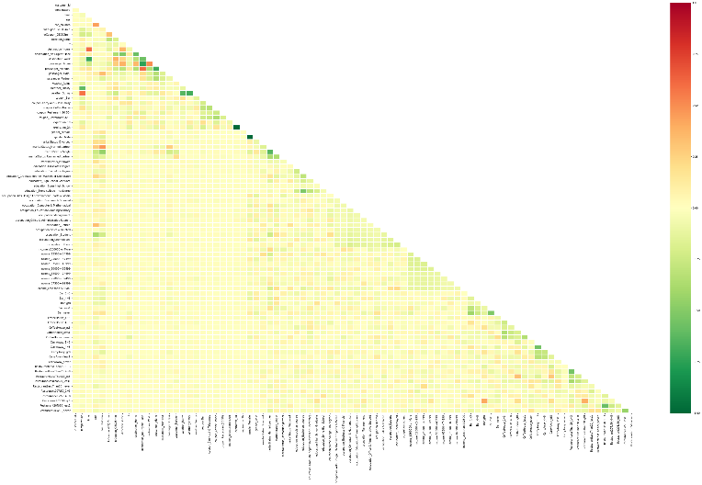
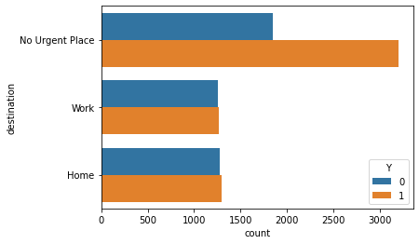
Section 02 : Data cleaning & EDA.
.
2. Univariate/ Bivariate/Multivariate analysis:
Bivariate:: Study the relationship that exists between two variables
Multicollinearity ::Relations ship between variables using Pearson method.
3. Descriptive analysis : High usage of Coupon when as below mentioned
Key customers are single who has Bachelor’s degree or studying in a school.
More accepted coupons :: Coffee House, Carry Out and Restaurant. So, need to prioritize.
Main customer base is coming in Sunny season.
Education is "Some college - No degree" or "Bachelors degree".
Occupation is "Student" or "Unemployed" or "Others".
Income range "$25000 - $37499“, "$37500 - $49999“,"$12500 - $24999“, "$100000 or More".
Never go to Bar.
Go to a Coffee House in between 1 to 3 times.
Get Take-Away food in between 1 to 3 times.
Go to a restaurant with an average expense per person of less than $20 in between 1 to 3 times.
Go to a restaurant with an average expense per person of $20 - $50, less than 1 time
Age group from 21 to 31 and 50+.
No Children

Slide 10
Deep Divers
HACKATHON 2022
【Approach】
Section 01 : Problem Statement.
Historical Data.
Type of Data & missing data
Planning – Milestone set-up.
Section 02 : Data cleaning & EDA.
Data cleaning & EDA.
Univariate/ Bivariate/Multivariate analysis.
Descriptive analysis.
Section 03 : Machine Learning & Model building.
ML Modeling – Logistic/Random forest/ Decision Tree.
Hyper tuning .
Record Various – Model performance.
Section 04 : Conclusion.
Comparison, GD & Selection – best ML Model .
Test result with Test Data set.

Slide 11
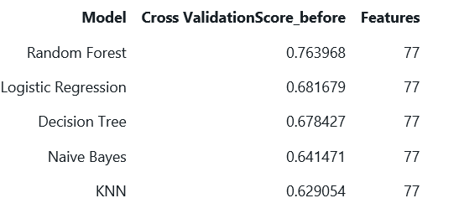
Section 03 : Machine Learning & Model building.
1. ML Modeling – Log./Random forest/ Decision Tree:.
Model Choosing
RandomForest performs the best among all the models in all given training datasets; The performances of others models are not comparable with provided dataset. KNN is the worst model because it is too simple for this classification task.
In conclusion, in this classification task, we could use Random Forest + Hyper tuning to achieve best Cross Validation Score.
2. Hyper tuning : Used random forest , entropy etc.
The Accuracy score of the model using Random Search is: 76.68% The Accuracy score of the model using Grid search is: 76.97%
3. Record Various – Model performance:
As per every submission , improved model.

Slide 12
Deep Divers
HACKATHON 2022
【Approach】
Section 01 : Problem Statement.
Historical Data.
Type of Data & missing data
Planning – Milestone set-up.
Section 02 : Data cleaning & EDA.
Data cleaning & EDA.
Univariate/ Bivariate/Multivariate analysis.
Descriptive analysis.
Section 03 : Machine Learning & Model building.
ML Modeling – Logistic/Random forest/ Decision Tree.
Hyper tuning .
Record Various – Model performance.
Section 04 : Conclusion.
Comparison, GD & Selection – best ML Model .
Test result with Test Data set.

Slide 13
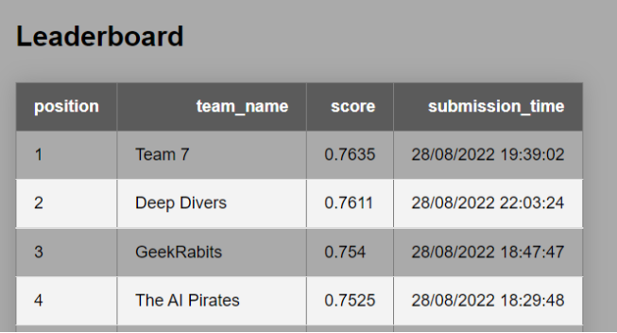
Section 04 : Conclusion.
.
The test accuracy of the model is 76.11% after submission of model. TEAM DEEP DIVERS.

Slide 14
Thank you.

